Slide 1
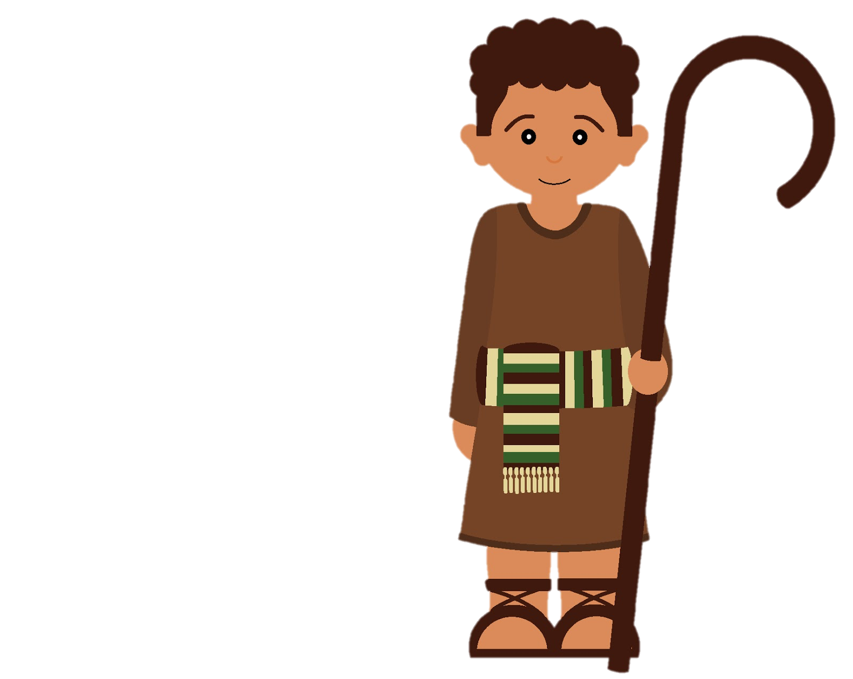

OU: a top-down look
Wolf!
Wolf!
Wolf!
Brian O’Meara
http://www.brianomeara.info
@omearabrian

Slide 2
In what ways can a continuous trait change in an instant of time?
Randomly: increase or decrease slightly by chance
and/or
Directionally: be pulled towards some value

Slide 3
In what ways can a continuous trait change in an instant of time?
Randomly: increase or decrease slightly by chance
and/or
Directionally: be pulled towards some value

Slide 4
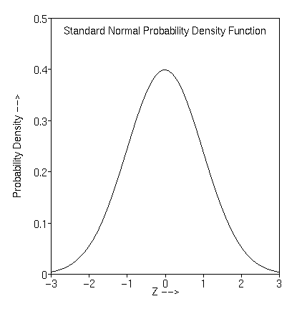
In what ways can a continuous trait change in an instant of time?
Randomly: increase or decrease slightly by chance
and/or
Directionally: be pulled towards some value

Slide 5
In what ways can a continuous trait change in an instant of time?
Randomly: increase or decrease slightly by chance
and/or
Directionally: be pulled towards some value
Rate of wiggle

Slide 6
In what ways can a continuous trait change in an instant of time?
Randomly: increase or decrease slightly by chance
and/or
Directionally: be pulled towards some value

Slide 7
In what ways can a continuous trait change in an instant of time?
Randomly: increase or decrease slightly by chance
and/or
Directionally: be pulled towards some value
Adds the entire difference

Slide 8
In what ways can a continuous trait change in an instant of time?
Randomly: increase or decrease slightly by chance
and/or
Directionally: be pulled towards some value
Allows directional change less than 100% (even zero)

Slide 9
In what ways can a continuous trait change in an instant of time?
Randomly: increase or decrease slightly by chance
and/or
Directionally: be pulled towards some value
Ornstein-Uhlenbeck process

Slide 10
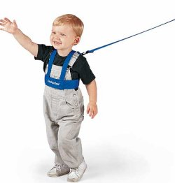

Ornstein-Uhlenbeck process

Slide 11
1
1
1
1
1

Slide 12
2
2
2
2
2

Slide 13
3
3
3
3
3

Slide 14
And so forth...
3
3
3
3
3

Slide 15
 | Single rate Brownian motion | Multiple mean Ornstein-Uhlenbeck | Multiple rate Brownian motion | Multiple everything
 | all equal | all equal | some vary | some vary
 | 0 | all equal | 0 | some vary
 | NA | some vary | NA | some vary
 | Independent contrasts (Felsenstein, 1985), ANCML (Schluter et. al, 1998) | Hansen, 1997; OUCH (Butler & King, 2004), SURFACE (Ingram & Mahler, 2012) | Brownie (O’Meara et al., 2006, Thomas et al., 2006), AUTEUR (Eastman et al. 2011) | OUwie (Beaulieu et al. 2012), bayou (Uyeda et al. 2014)
Brownian rate
OU attraction
OU mean

Slide 16
 | Single rate Brownian motion | Multiple mean Ornstein-Uhlenbeck | Multiple rate Brownian motion | Multiple everything
 | all equal | all equal | some vary | some vary
 | 0 | all equal | 0 | some vary
 | NA | some vary | NA | some vary
 | Independent contrasts (Felsenstein, 1985), ANCML (Schluter et. al, 1998) | Hansen, 1997; OUCH (Butler & King, 2004), SURFACE (Ingram & Mahler, 2012) | Brownie (O’Meara et al., 2006, Thomas et al., 2006), AUTEUR (Eastman et al. 2011) | OUwie (Beaulieu et al. 2012), bayou (Uyeda et al. 2014)
Brownian rate
OU attraction
OU mean
Notes:
Note, one alpha, one sigma

Slide 17
Model | Optima (mean = M) | Sigma (variance = V) | Attraction (A)
BM₁ |  | 1
BM_{S} |  | ≥2
OU₁ | 1 | 1 | 1
OU_{M} | ≥2 | 1 | 1
OU_{MA} | ≥2 | 1 | ≥2
OU_{MV} | ≥2 | ≥2 | 1
OU_{MVA} | ≥2 | ≥2 | ≥2
Beaulieu, Jhwueng, Boettiger, O'Meara 2012

Slide 18
Modeling stabilizing selection: expanding the Ornstein-Uhlenbeck model of adaptive evolution
Modeling “stabilizing selection”: expanding the Ornstein-Uhlenbeck model of adaptive evolution
Beaulieu, Jhwueng, Boettiger, O'Meara 2012

Slide 19
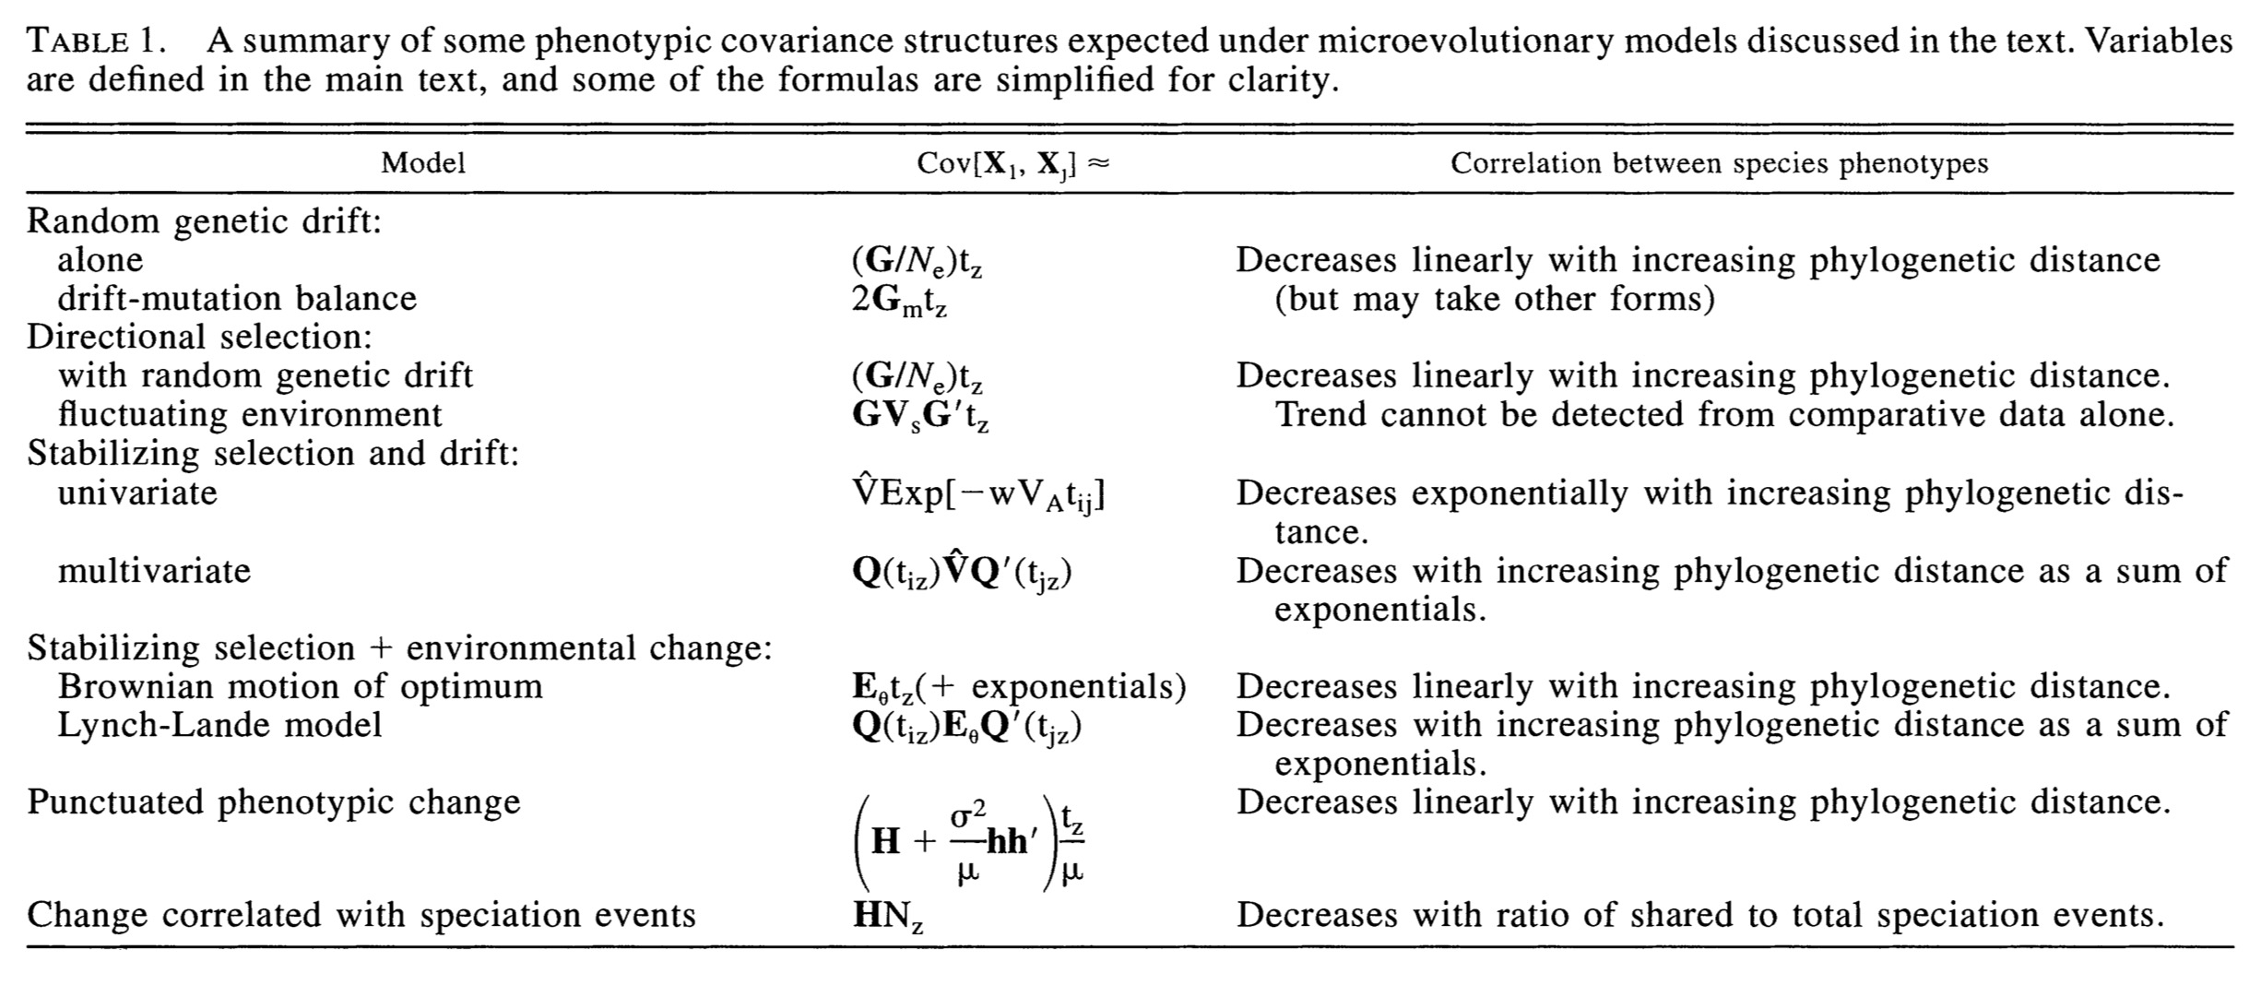
Hansen & Martins 1996

Slide 20
🤕
👎
👎
🤷
Hansen & Martins 1996
Notes:
All the hearts are Brownian Motion

Slide 21
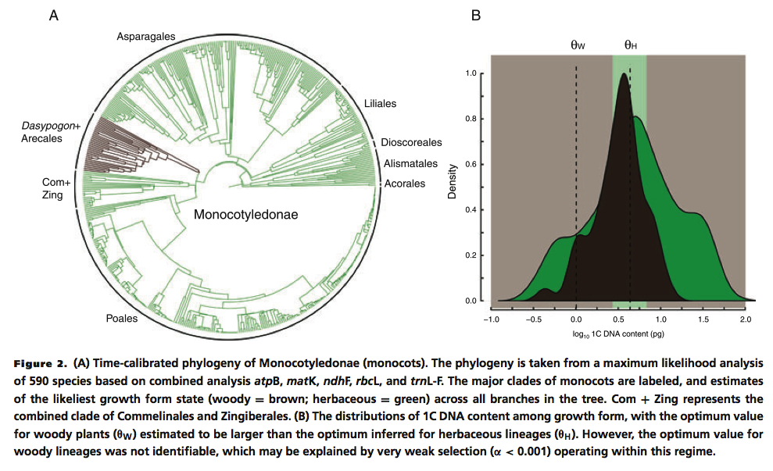
Beaulieu, Jhwueng, Boettiger, O'Meara 2012

Slide 22
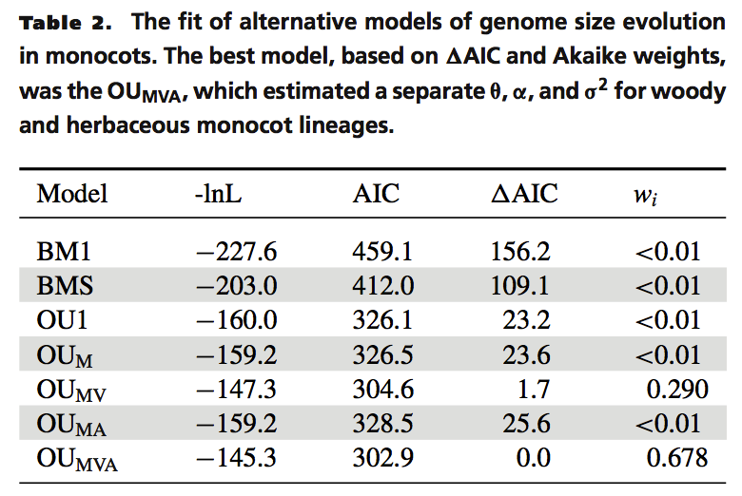
Beaulieu, Jhwueng, Boettiger, O'Meara 2012

Slide 23
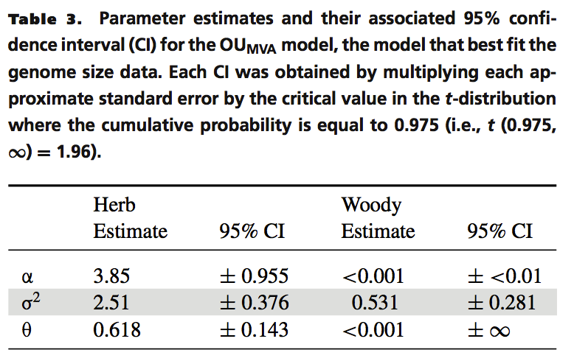
Beaulieu, Jhwueng, Boettiger, O'Meara 2012
Notes:
Note the scary CI for theta for woody

Slide 24
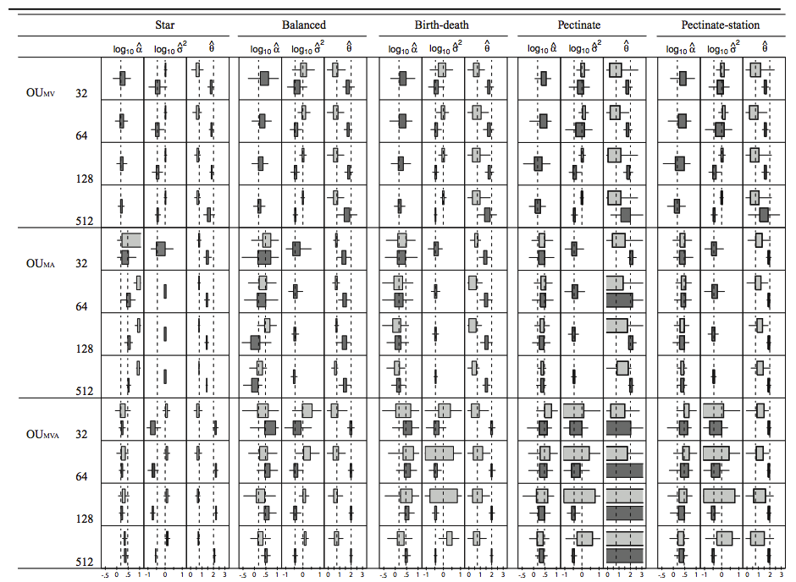
Beaulieu, Jhwueng, Boettiger, O'Meara 2012
Notes:
And here's where we went crazy. Boxes should be small and centered on the dashed lines. These sims had a single regime shift. Note that for some models and trees, even trees with over 500 taxa had trouble estimating parameters wel

Slide 25
How do we figure out painting?

Slide 26
How do we figure out painting?
a priori biological hypotheses
Reconstruct a discrete trait, use that to paint continuous regimes
Slice by taxonomy (monocots vs other plants)
Slice by time (pre and post KT)
Try a bunch (i.e. SURFACE)

Slide 27
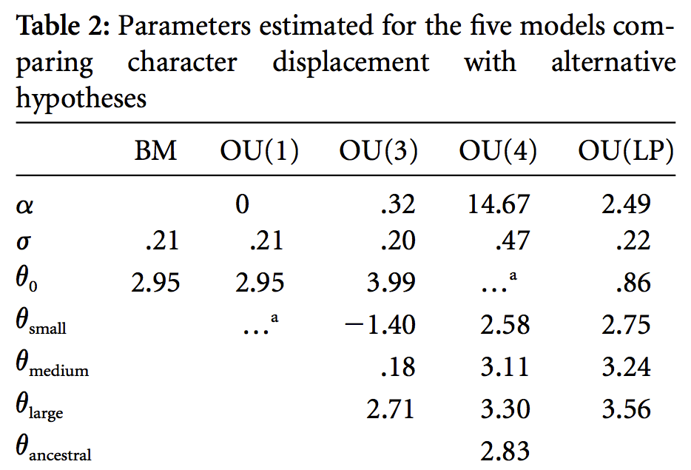
Phylogenetic half life
= Tree height scaling × ln(2) / α
= 30 MY × ln(2) / 2.49
= 8.4 MY
to go halfway from log(25 mm) to log(35 mm) head lengths: 0.6 mm/MY, or 0.24% of the starting value/MY
Notes:
another issue is scale. Also, note the units. New version of OUwie on github gives half life

Slide 28
Model rejection / selection
Is Model B better than Model A
Can I reject a null?

Slide 29
Model rejection
Wolf!
Wolf!
Wolf!
Type I error: Townspeople incorrectly accept a wolf is there (reject a true null).
Type II error: Townspeople incorrectly deny a wolf is there (incorrectly accept a false null).
Type ? error

Slide 30
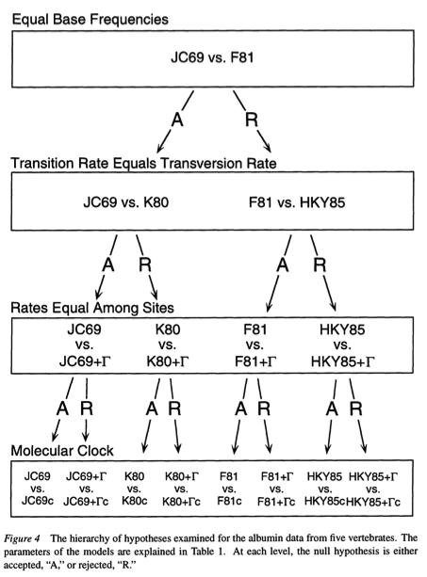
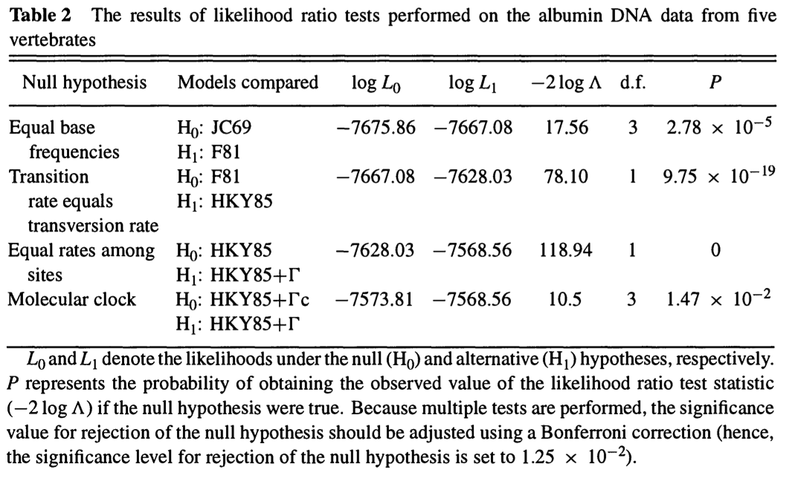
Huelsenbeck & Crandall 1997

Slide 31
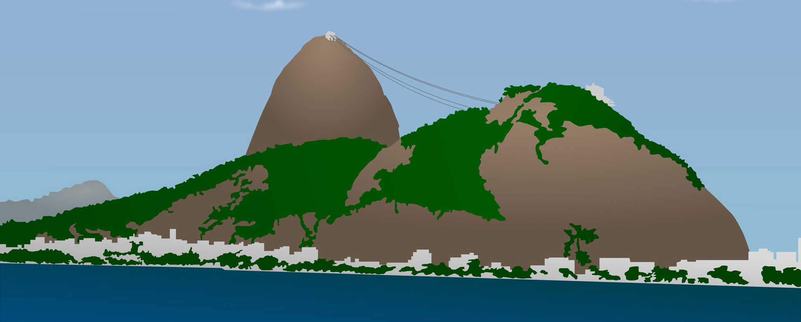
Reality
Model
Reality ≠ Model
Q: How much information about reality does the model lose?
A1: Kullback-Leibler distance
A2: Akaike Information Criterion estimates KL distance

Slide 32
Reality
Model
A2: Akaike Information Criterion estimates KL distance
AIC: -2 log(likelihood) + 2 (# free parameters)

Slide 33
Two models
Model A
AIC_{A} = 402
∆AIC_{A} = 5
weight_{A} = 0.08
Model B
AIC_{B} = 397
∆AIC_{B} = 0
weight_{B} = 0.92

Slide 34
Akaike Information Criterion: Want the model that minimizes the information lost. Complex idea, simple to calculate (2 × #parameters - 2 ln(L)). Generally, one subtracts the smallest AIC from a set of models from the values for all models to get ∆AIC (so best, lowest AIC, model has ∆AIC≡0).
Advantages: doesn’t require nested models. Based on information theory. Allows model weighting.
Notes:
Distance from Boston as example

Slide 35
AIC
∆AIC | Level of empirical support for model
0 – 2 | Substantial
4 – 7 | Considerably less
10+ | Essentially none
Burnham & Anderson 2004
Notes:
Note: no mention of significance

Slide 36
Things folk tend to misunderstand with AIC
It is not a significance measure.
No, really. Not even ∆2. Just stop.
The best model isn’t always the true model.
The true model doesn’t have to be in the set of models.
In our field, the true model is NEVER in the set of models (outside of simulation world).

Slide 37
k = # free parameters
n = number of data points
AIC: -2 log(likelihood) + 2 k
AICc: -2 log(likelihood) + 2 k * (n / (n – k – 1))
BIC: -2 log(likelihood) + log(n) * k
AICc has a correction for small sample size.
BIC is Bayesian Information Criterion (but easiest to think of as another information criterion). Regular AIC tends to overfit.
What is n?
Notes:
What does overfit mean?

Slide 38
Model rejection
Wolf!
Wolf!
Wolf!
Type I error: Townspeople incorrectly accept a wolf is there (reject a true null).
Type II error: Townspeople incorrectly deny a wolf is there (incorrectly accept a false null).
Type ? error

Slide 39
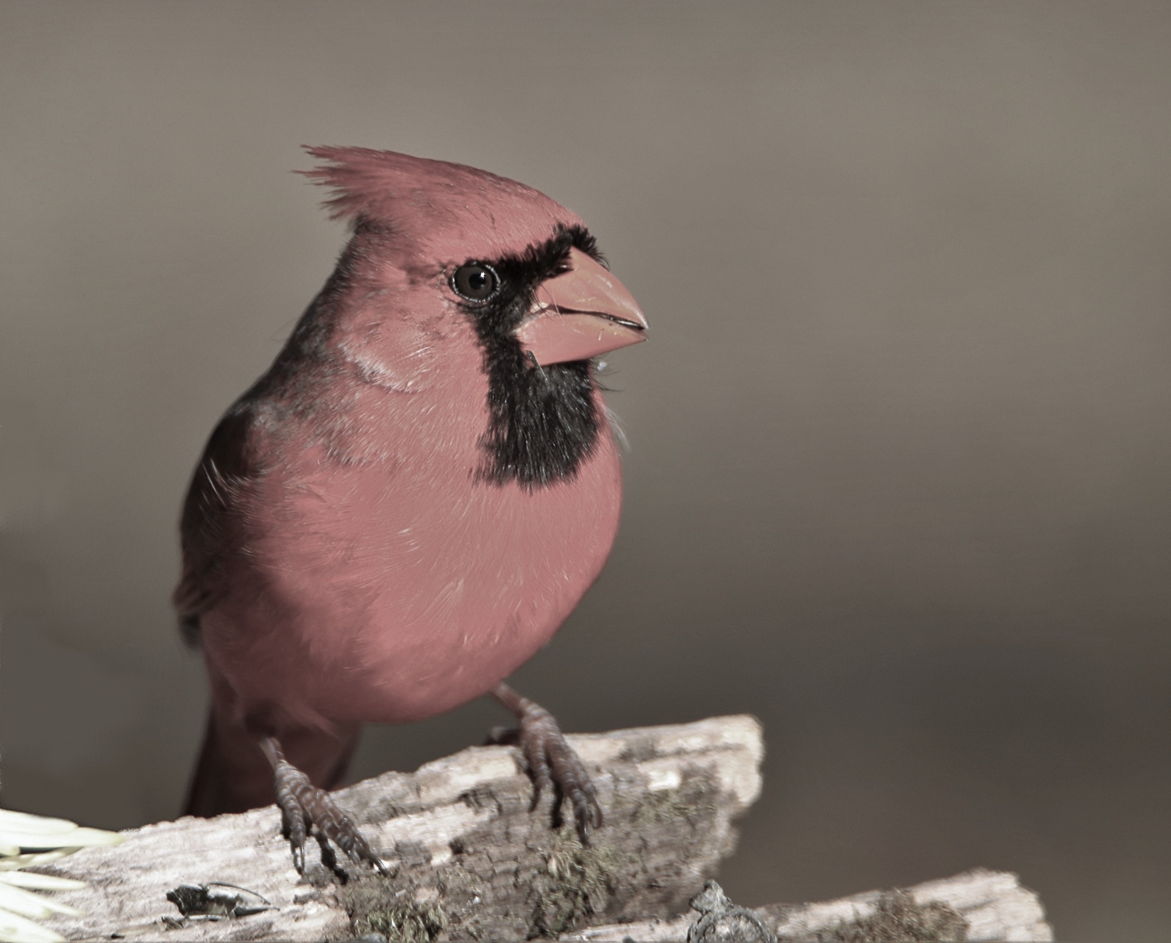
Parameter estimation
Hypothesis 1
When carotenoids are simply strictly limiting color signal elaboration, we expect a BM model with similar rates of change (σ²) between lineages with and without carotenoid-dependent traits to be favored. Although commonly interpreted as a “pure drift” model, a BM model may also reflect the pattern of lineages evolving toward phylogenetically structured, lineage-specific adaptive optima, which are randomly structured in relation to the considered factors (Revell et al. 2008)….
Hypothesis 2
When carotenoids are a limiting resource, we expect a single optimum OU model to be favored. Selection to maintain or increase plasma carotenoid level is independent of the presence of carotenoid-dependent ornaments, because carotenoids provide physiological resource benefits irrespective of the presence of sexual signaling. Thus we expect strong attraction toward this optimum, with possibly higher attraction (or lower evolutionary rates) in lineages that exhibit carotenoid-dependent traits, because sexual selection within these linages is predicted to enhance selective pressures, thereby maintaining carotenoid levels closer to the shared optimal value.
Hypothesis 3
When carotenoids are not a limiting resource and are mostly used as a pigment, we expect an OU model with two optima—one lower optimum with low attraction (weak stabilizing selection) in lineages lacking carotenoid-dependent traits and a higher optimum with stronger attraction in lineages that do exhibit carotenoid-dependent traits—to be preferred. If carotenoids are not a physiological resource, natural selection should not drive the evolution of plasma carotenoid levels to be high in the absence of carotenoid-dependent sexual signals. In contrast, in lineages with carotenoid-dependent traits, sexual selection is expected to select for higher carotenoid levels (higher optima), which will mostly be used for signal pigmentation.
Simons, Maia, Leenknegt, and Verhulst 2014 (bold added by me)

Slide 40
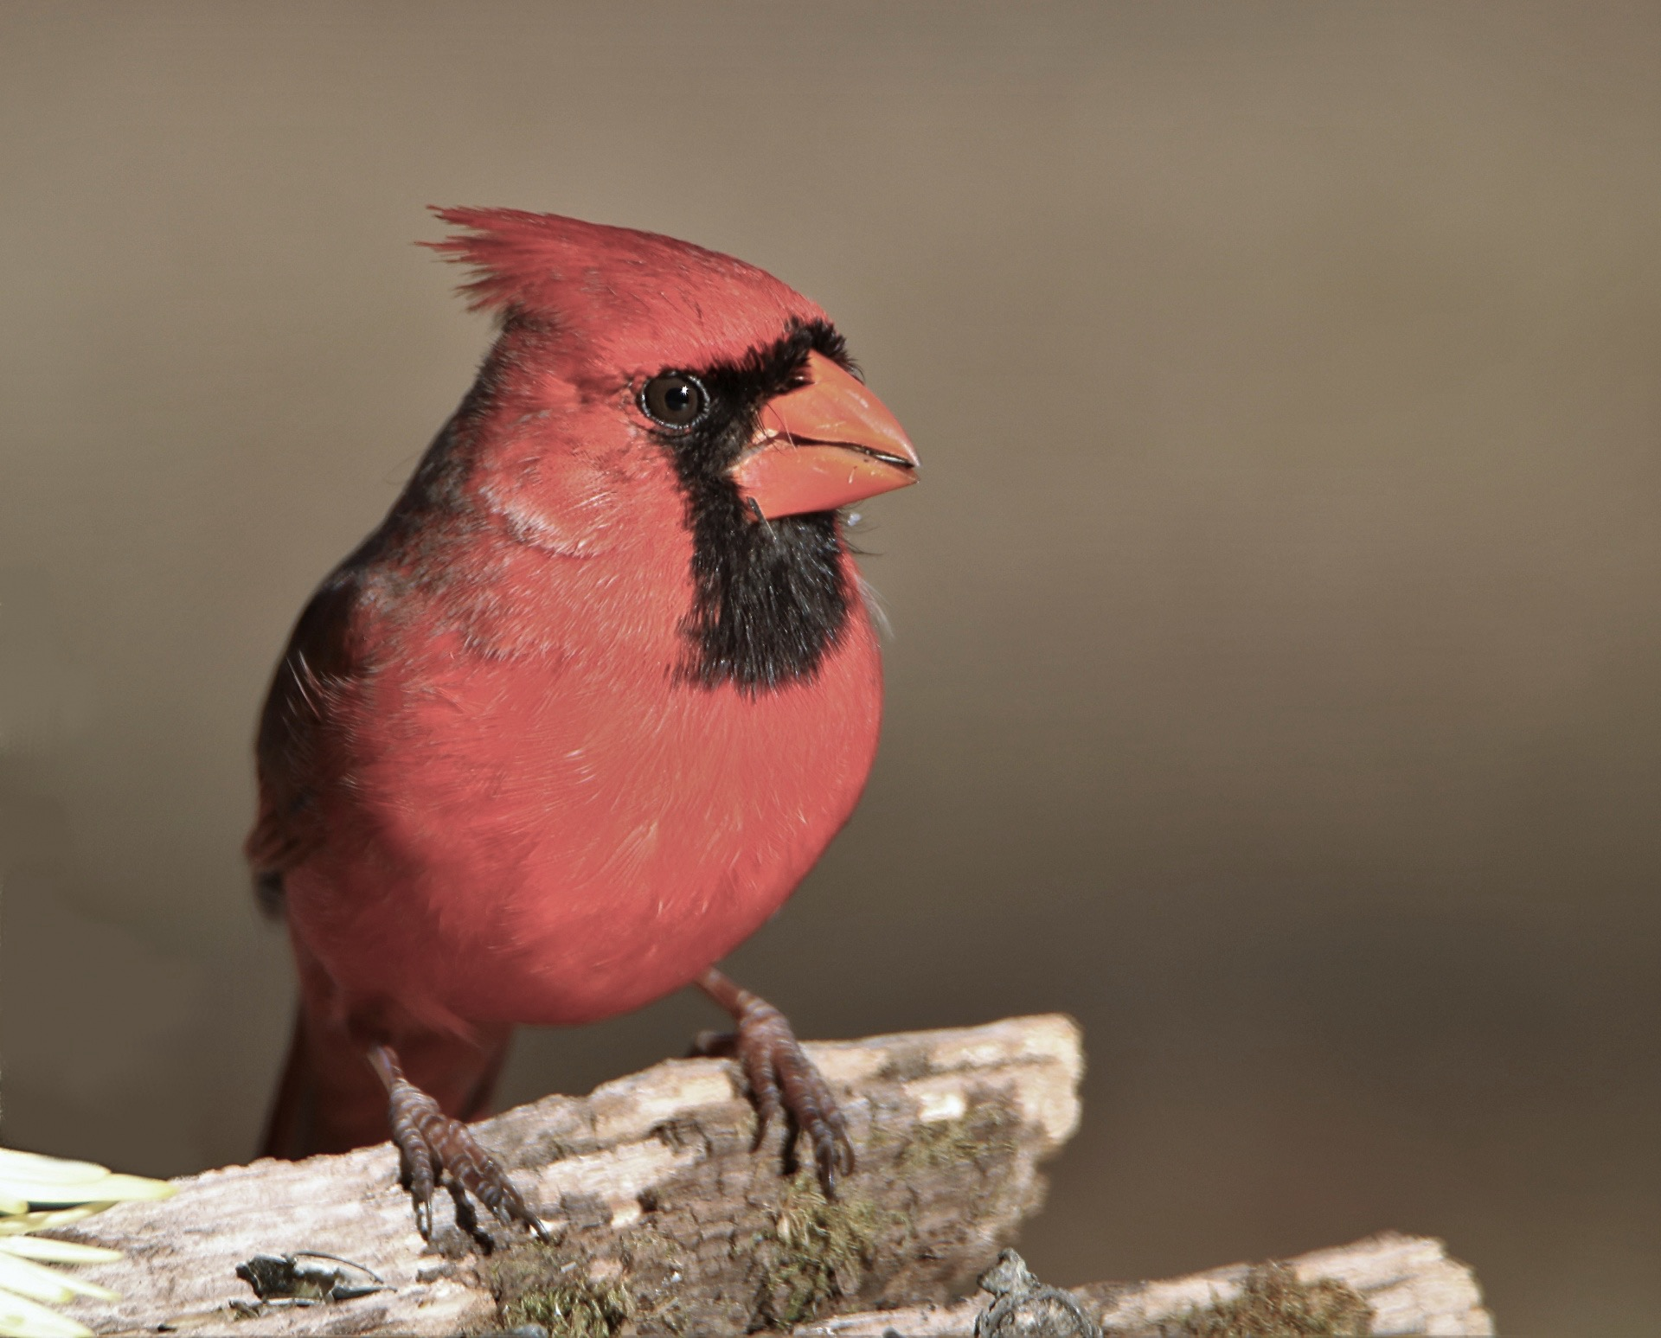
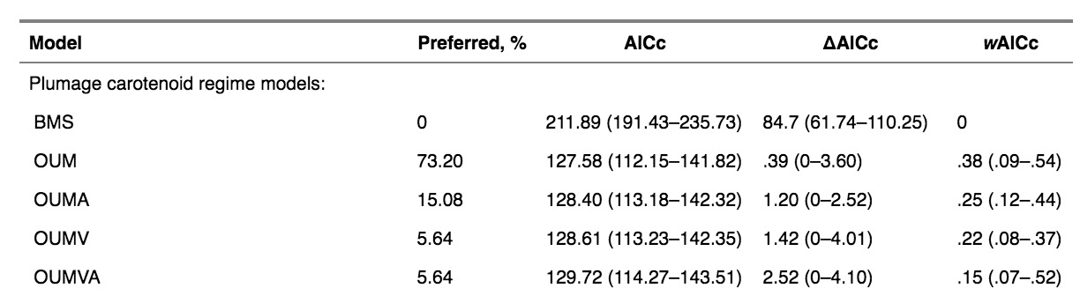
Parameter estimation
Simons, Maia, Leenknegt, and Verhulst 2014

Slide 41
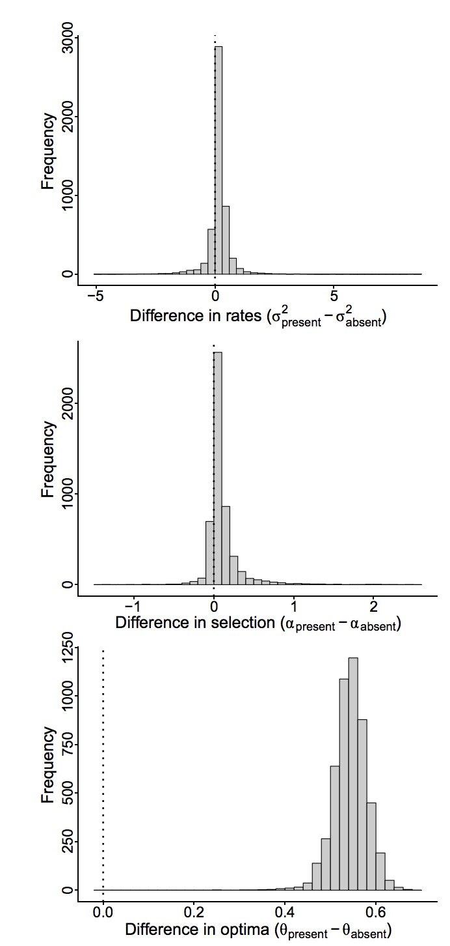
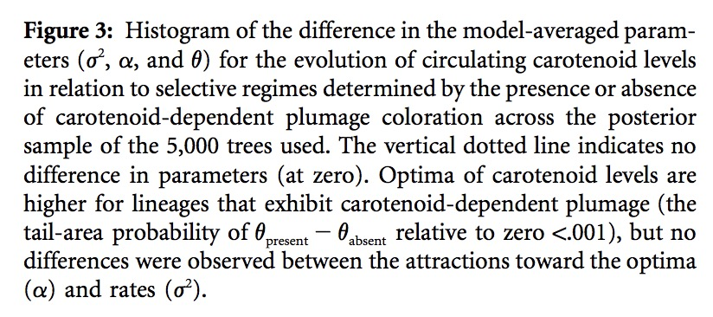
Simons, Maia, Leenknegt, and Verhulst 2014

